Slide 1
Ontologies using OWL and SHACL
Capgemini Academy
Company confidential

Slide 2
House Rules
Breaks every 60 minutes (or so)
Lunch at …
Ask questions at any time
Minimize non-training information input...

Slide 3
Agenda
01
Introductions
02
Linked Data/RDF recap
03
OWL vs SHACL?
04
Deep dive: OWL
05
Deep dive: SHACL

Slide 4
Introductions

Slide 5

About Me
Amir Westhoff
Joined Capgemini in 2018
Managing Consultant / Information Architect
Worked with Linked Data/RDF since 2018 at:
Logius
Dutch Police
Ministry of General Affairs
UWV
Wrote three articles on Linked Data/RDF for Capgemini publications
Developed three Capgemini Academy trainings

Slide 6

What about you?
What is your name?
What type of roles have you had in recent times?
Does your current job/assigment involve Linked Data/RDF/ontologies/knowledge graphs?
Is there anything particular you would like to learn in this training?

Slide 7
Capgemini Academy trainings on Linked Data
Ontologies using OWL and SHACL
Introduction to Linked Data
Taxonomies and Thesauri in SKOS
Foundation
Practitioner
Expert

Slide 8
Linked Data/RDF
recap

Slide 9
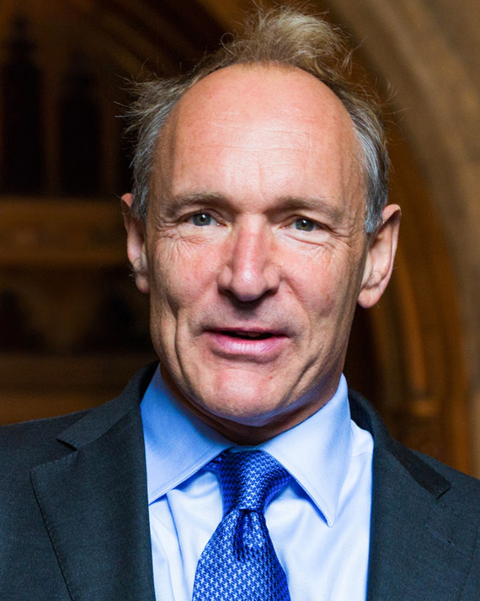
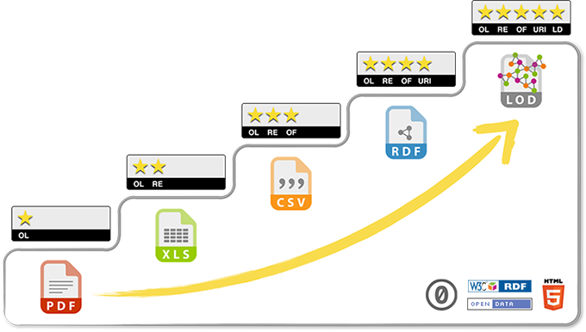
Linked Data 101
Linked Data is data that follows the open W3C-standard Resource Description Framework (RDF) and relevant best practices
RDF was invented by Tim Berners-Lee at W3C
Also called Linked Open Data, but principles can also be applied to closed data
Basically, a different way of dealing with data, using open (web) standards
Related concepts: Knowledge Graphs, FAIR data

Slide 10
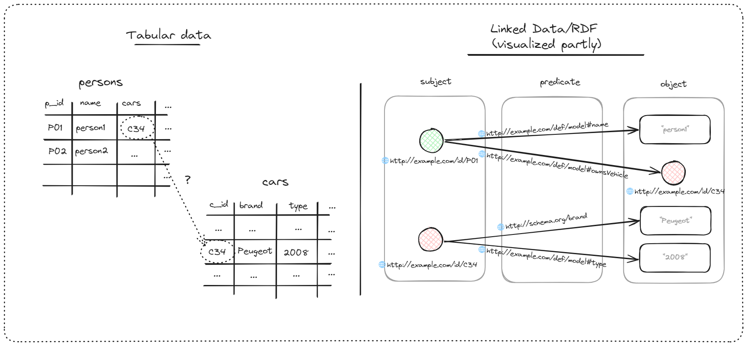
Linked Data 101
Tabular data vs Linked Data/RDF
Implicit semantics
HTTP-URIs as identifiers
(Explicit) Semantics can be reused
Relationships also have identity
Data in a graph paradigm

Slide 11
Five take-aways
Data interoperability
Relationships are first class citizens
Data in graph paradigm
Model is part of the data
Reuse of URIs and semantics
RDF triples allow easy merging of data
Relationships can be annotated, have subproperties, etc.
Model elements are thus available
for analysis, querying, and advanced capabilities
Operations that draw from graph theory are performed easier than with tables
By reusing HTTP-URIs from other parties,
semantics are also reused

Slide 12
RDF Vocabularies
An RDF vocabulary is a collection of concepts and relationships, published as RDF, that have been previously defined (by working groups) for a specific use case
Several ubiquitous vocabularies:
RDF vocabulary | Full name | Use case
RDF | Resource Description Framework | Basic building blocks for having data as RDF
RDFS | RDF Schema | Simple schema
OWL | Web Ontology Language | Ontologies based on first order logic/set theory and in an open world assumption
SHACL | Shapes Constraint Language | Data validation / ontologies in a closed world assumption
SKOS | Simple Knowledge Organization Systems | Taxonomies, thesauri, simple concepts and concept schemes

Slide 13
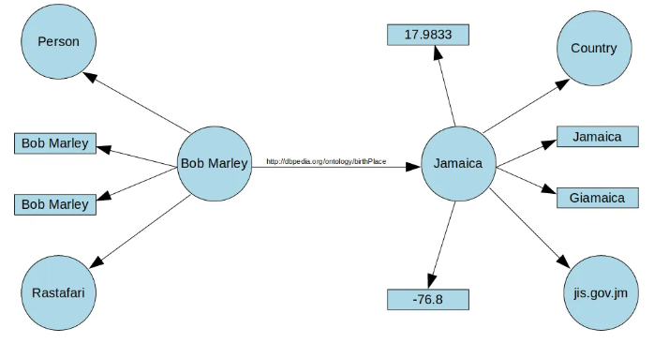
Reading Linked Data/RDF
RDF has various serialization forms: N3-Triples, XML, JSON-LD, Turtle
Below graph will be used as example

Slide 14
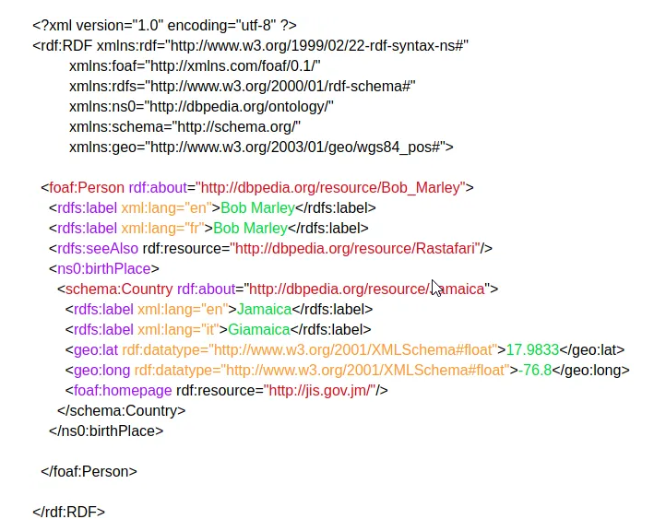
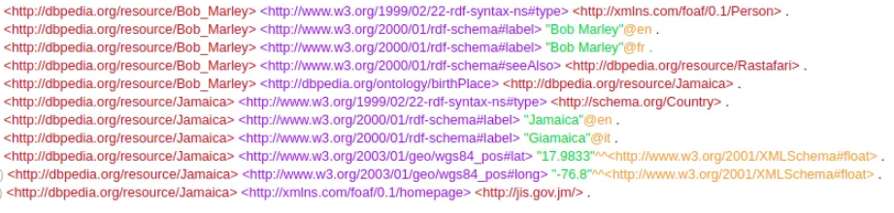
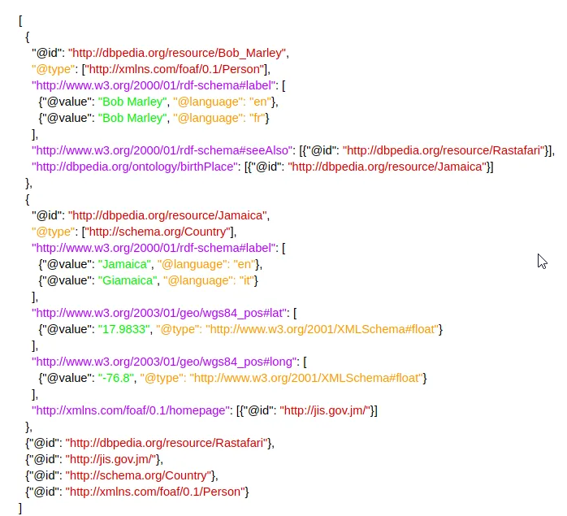
Reading Linked Data/RDF
N3-Triples, JSON-LD, RDF/XML: All RDF, but...
N3-Triples
RDF/XML
JSON-LD

Slide 15
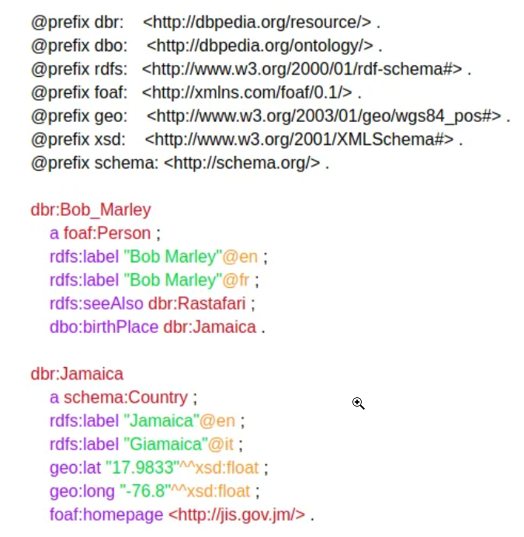
Reading Linked Data/RDF
..., the Turtle syntax offer the best readability for humans
Turtle
Prefixes for shortening URIs
No need to repeat the subject when using the semicolon (“;”). Close off the list of predicate-object combinations with a period (“.”) .
Only the space between subject – predicate – object is important

Slide 16
Reading Linked Data/RDF
Some conventions
Turtle
relationships/attributes in camelCase
Classes begin with capitalized letter

Slide 17
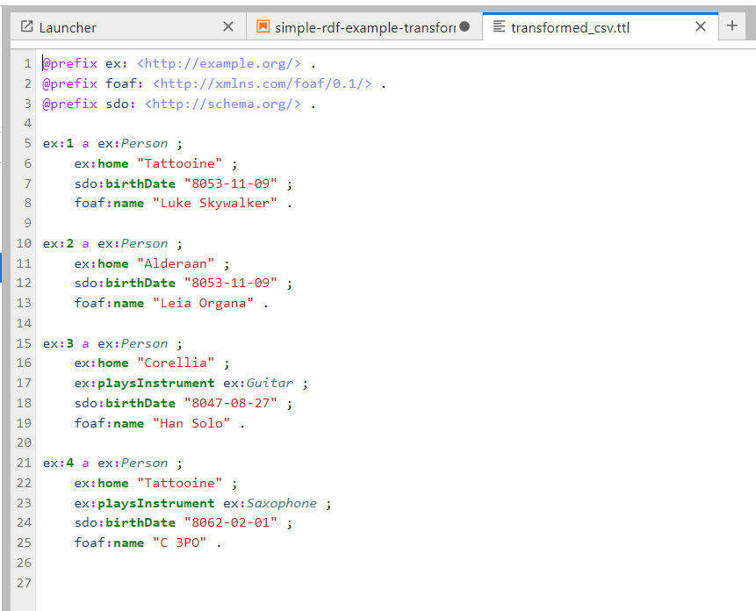
Notebook: simple-rdf-example-transformations.ipynb
Let’s open the `simple-rdf-example-transformations.ipynb` notebook

Slide 18
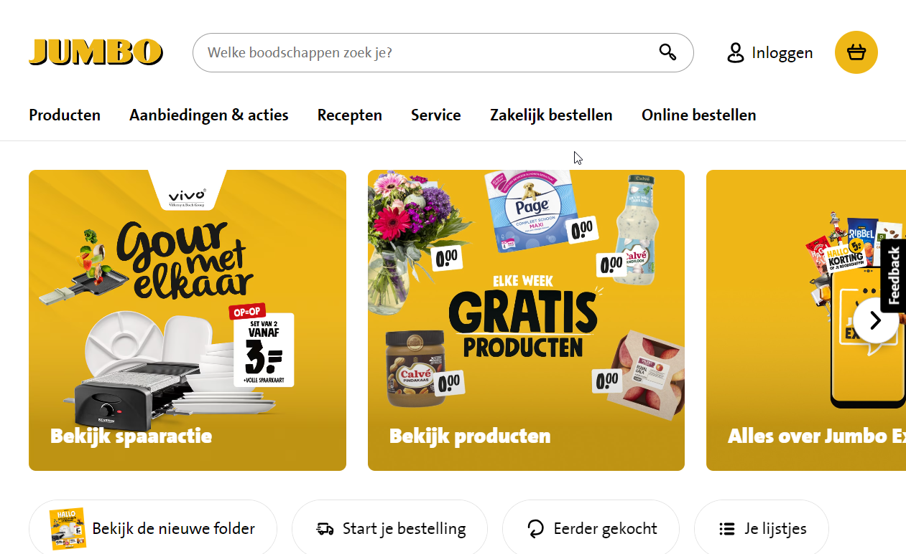
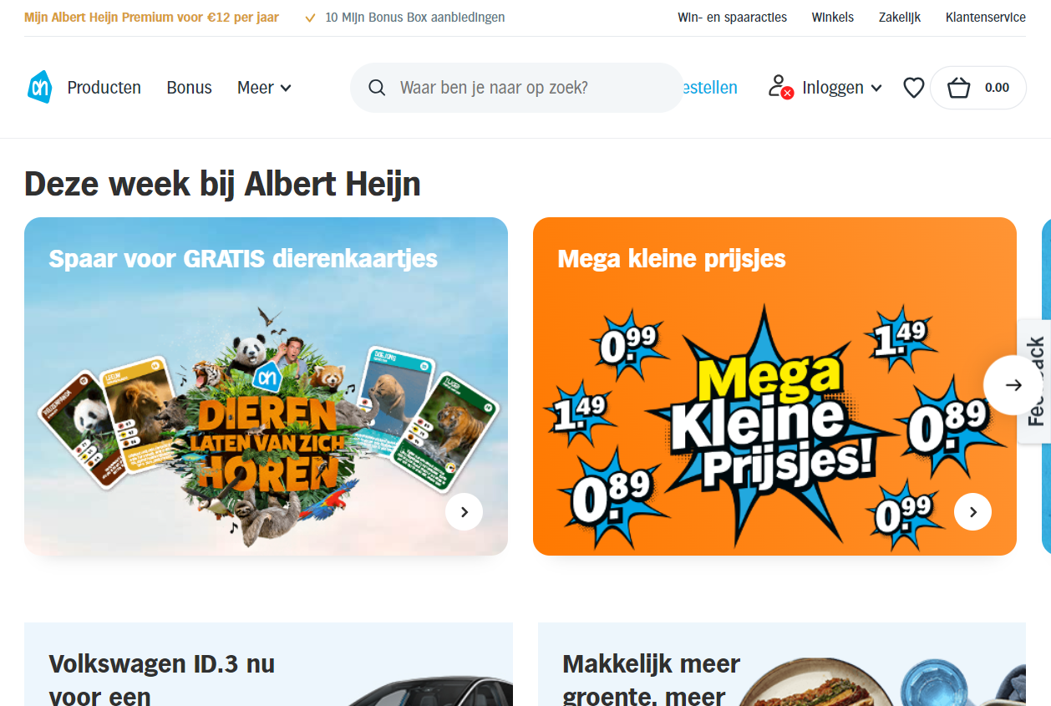
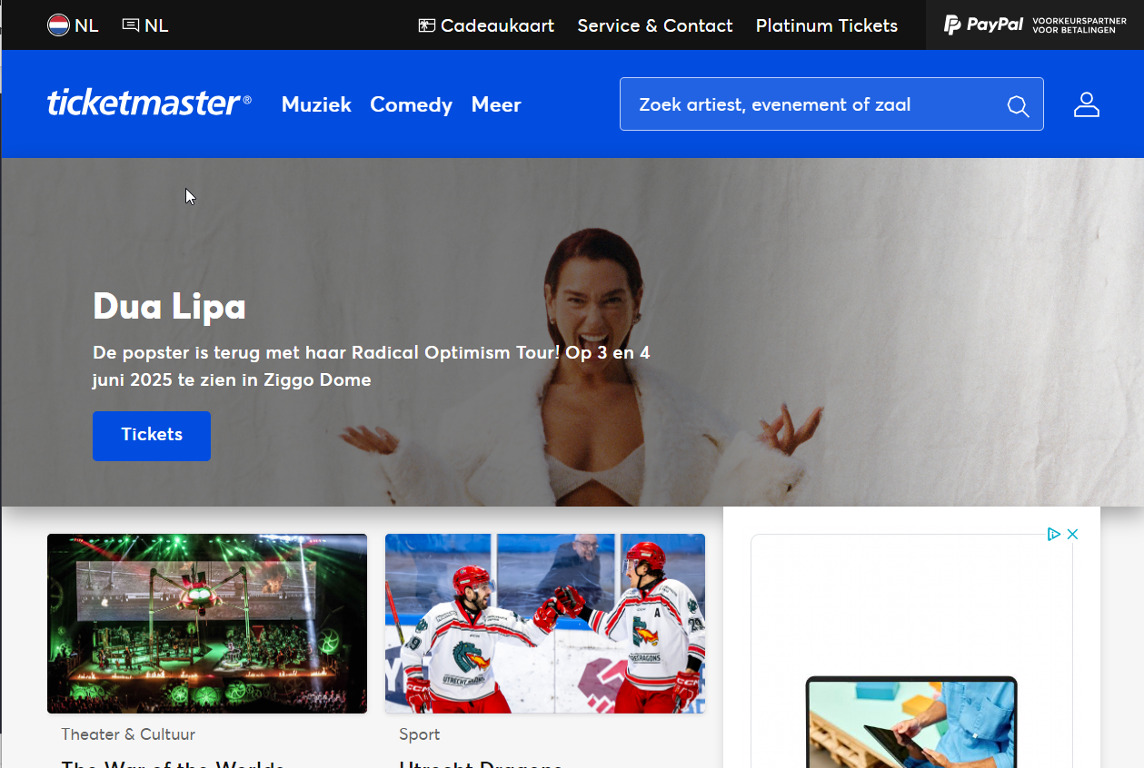
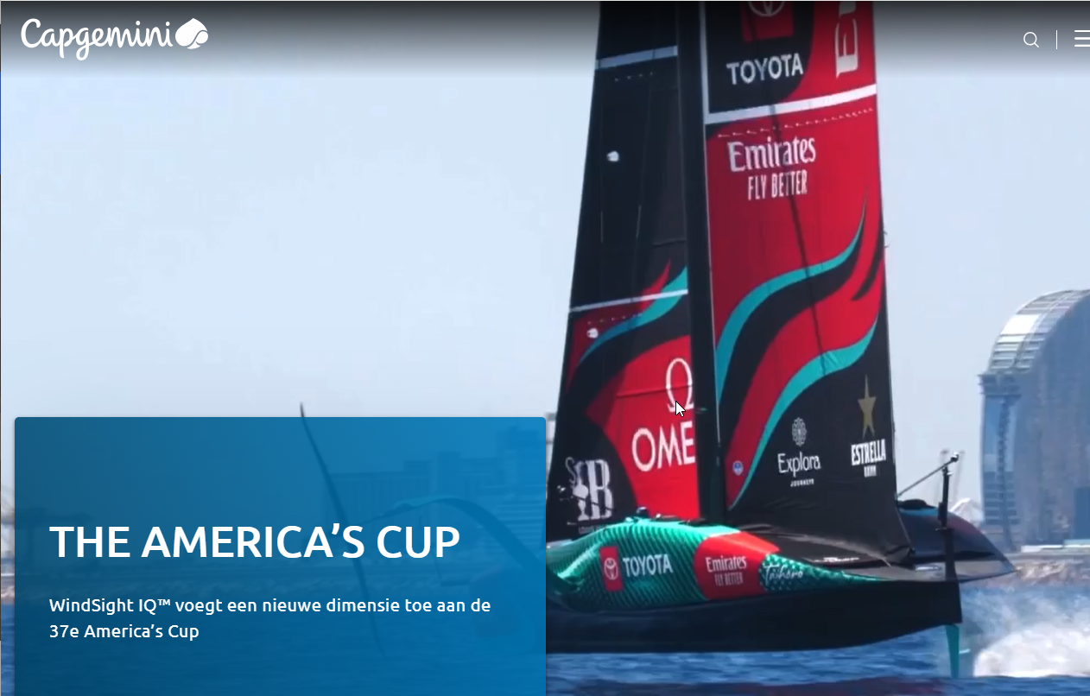
Discussion
What are your thoughts on RDF so far?
Exotic?
Any thoughts on why adoption has (presumably) been slow?
Or has it?

Slide 19
References / Recommend reading
https://5stardata.info/en/
https://www.w3.org/wiki/LinkedData
https://www.w3.org/TR/turtle/

Slide 20
OWL vs SHACL?

Slide 21
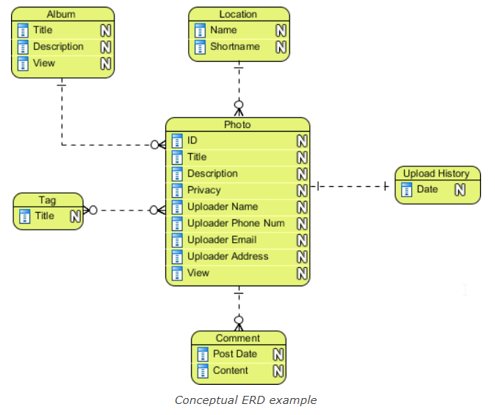
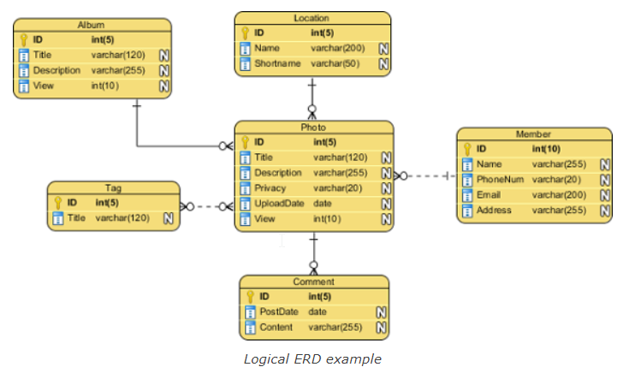
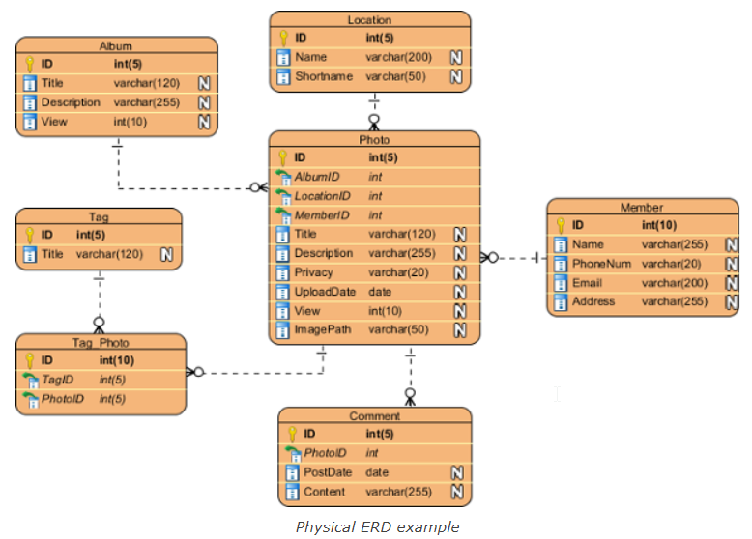
Discussion
First: What are your experiences with data modeling?
Conceptual > Logical > Physical?
Other?
How do you model relationships?

Slide 22
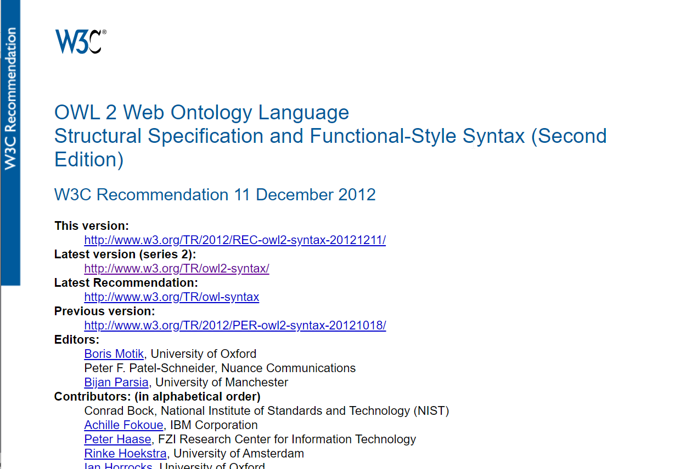
OWL
Web Ontology Language
2012
Built on top of RDFS (RDF Schema)
Designed to enable reasoning based on description logic and set theory
Open World Assumption

Slide 23
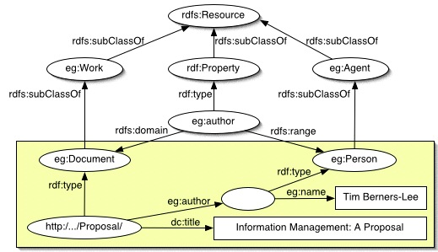
OWL
Let’s look at RDFS first
Sufficient for simple schemas/hierarchies
Not possible to characterize relationships (symmetrical, transitive, etc.)
Not possible to specify class disjointness
As we will see: more expressivity with OWL

Slide 24
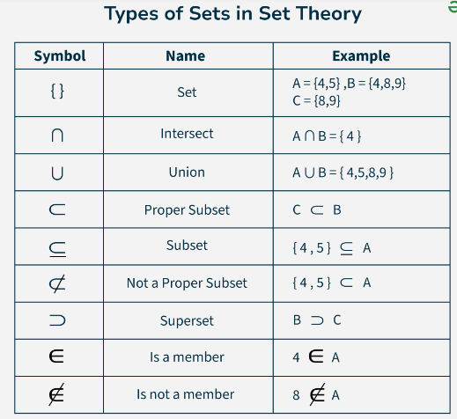
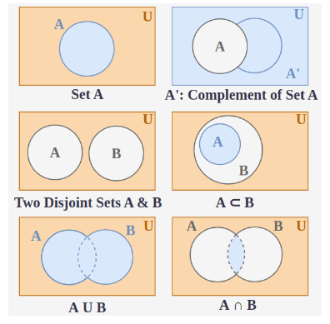
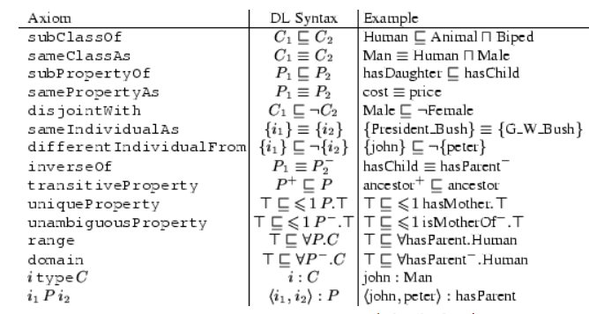
OWL
Set theory and description logics
Set theory: mathematical reasoning over sets
Description logics: mathematical reasoning over concepts
As we will see: OWL enables logic/mathematical reasoning

Slide 25
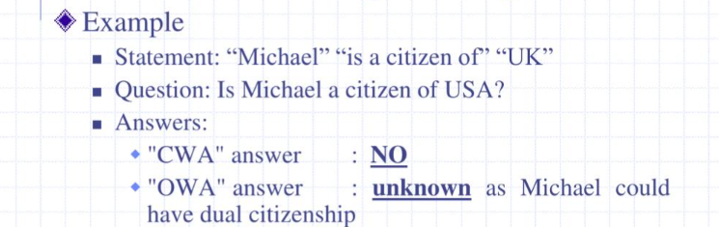
OWL
Open World Assumption (vs Closed World Assumption)
Open World Assumption
If you cannot prove something, we do not know its status
Normal assumption when applying logic
Closed World Assumption
If you cannot prove something, assume it is false
When it is assumed that the knowledge base is complete, or incomplete but decision must be made regardless
→ OWL was designed for the Semantic Web, where you know you don’t have all information

Slide 26
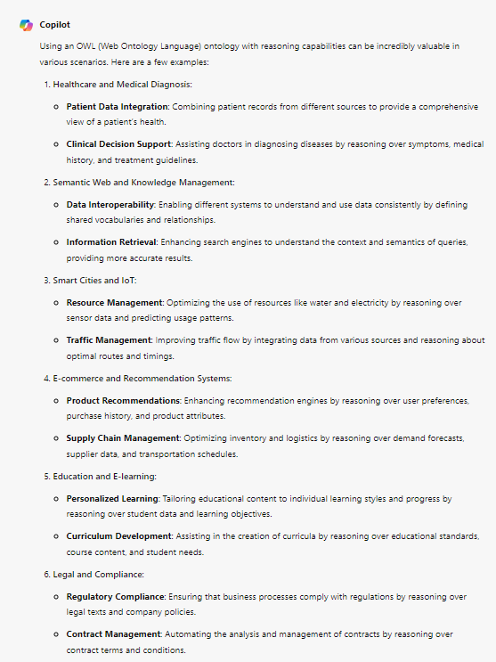
Question: Can you think of a case where OWL reasoning could be of value?
Copilot suggests:
Healthcare and Medical Diagnosis
Semantic Web and Knowledge Management
Smart Cities and IoT
E-commerce and Recommendation Systems
Education and E-learning
Legal and Compliance
...

Slide 27
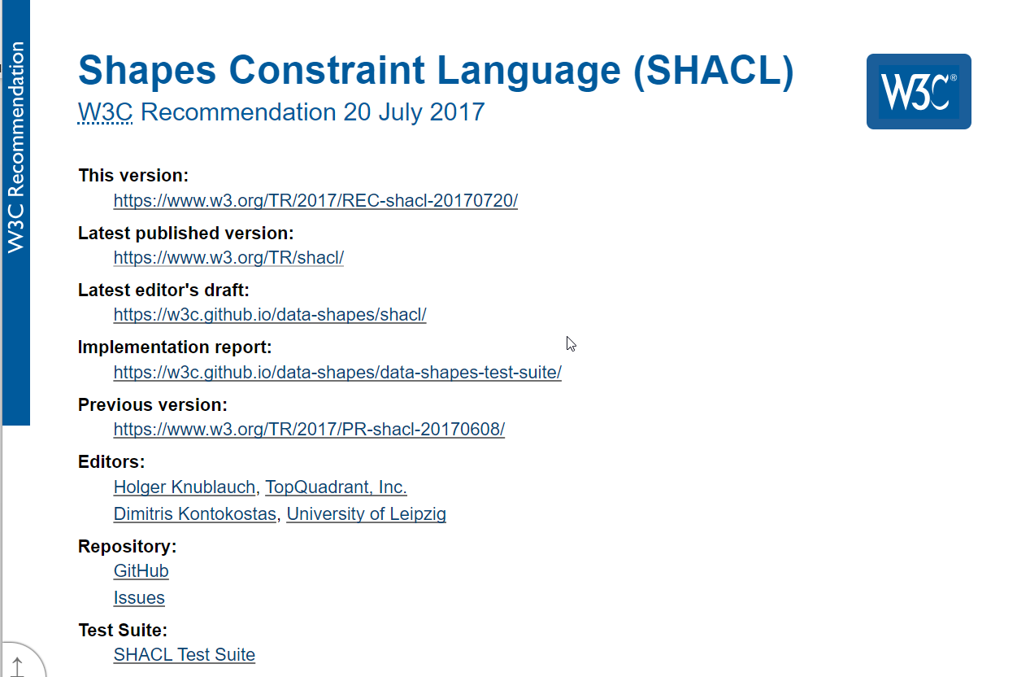
SHACL
Shapes Constraint Language
2017
Designed for RDF data validation
Closed World Assumption

Slide 28
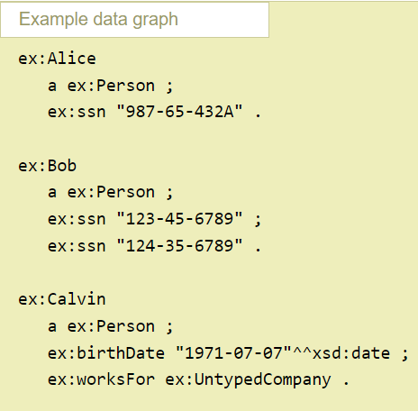
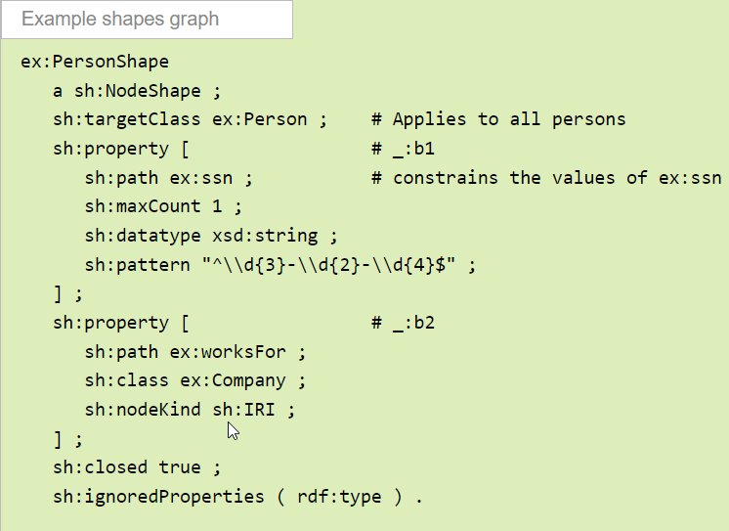
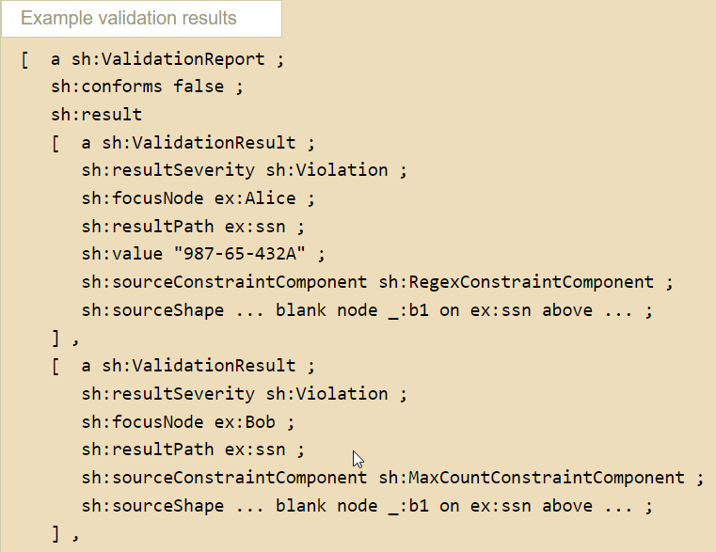
SHACL
Shapes Graph + Data Graph → Validation Report
SHACL gives you primitives to model node shapes and property phapes
SHACL shapes can also be shared as Linked Data
Note that you can also refer to concepts and relationships from other ontologies/vocabularies

Slide 29
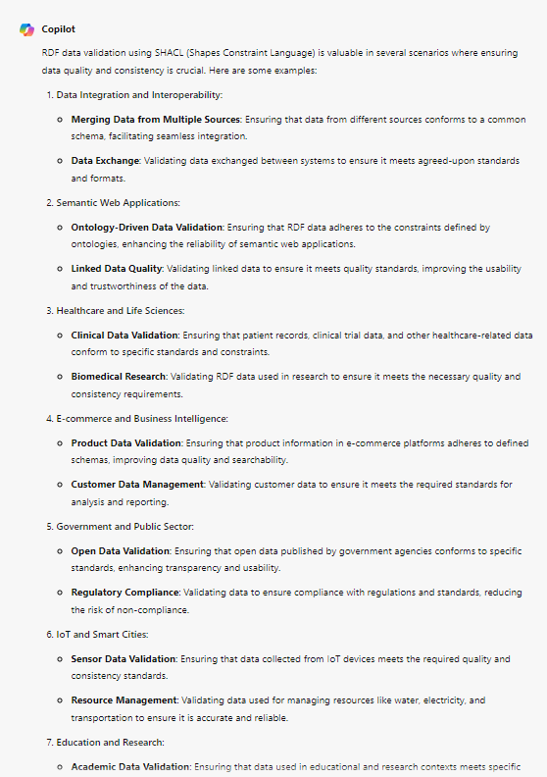
Question: Where would you apply SHACL?
Copilot suggests:
Data Integration and Interoperability
Semantic Web Applications
Healthcare and Life Sciences
E-commerce and Business Intelligence
Government and Public Sector
IoT and Smart Cities
Education and Research

Slide 30
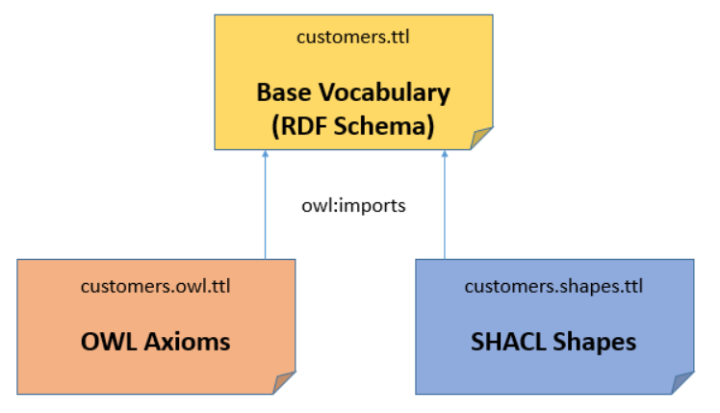
First: OWL and SHACL?
They can be used together
With OWL you can model logical axioma for inferencing
Since OWL does not impose constraints on the data, this can be done with SHACL shapes
You can model these files/graphs separately and only use them when needed

Slide 31
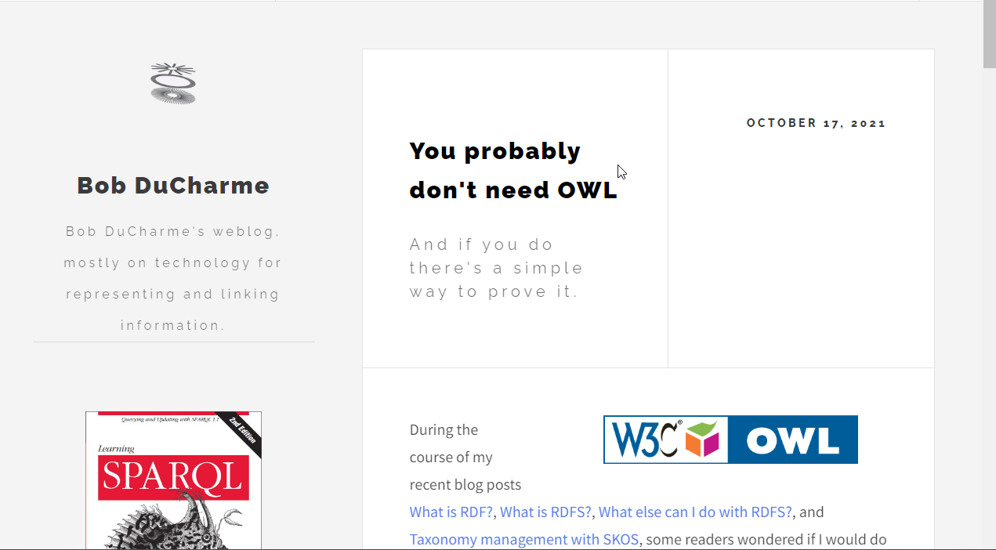
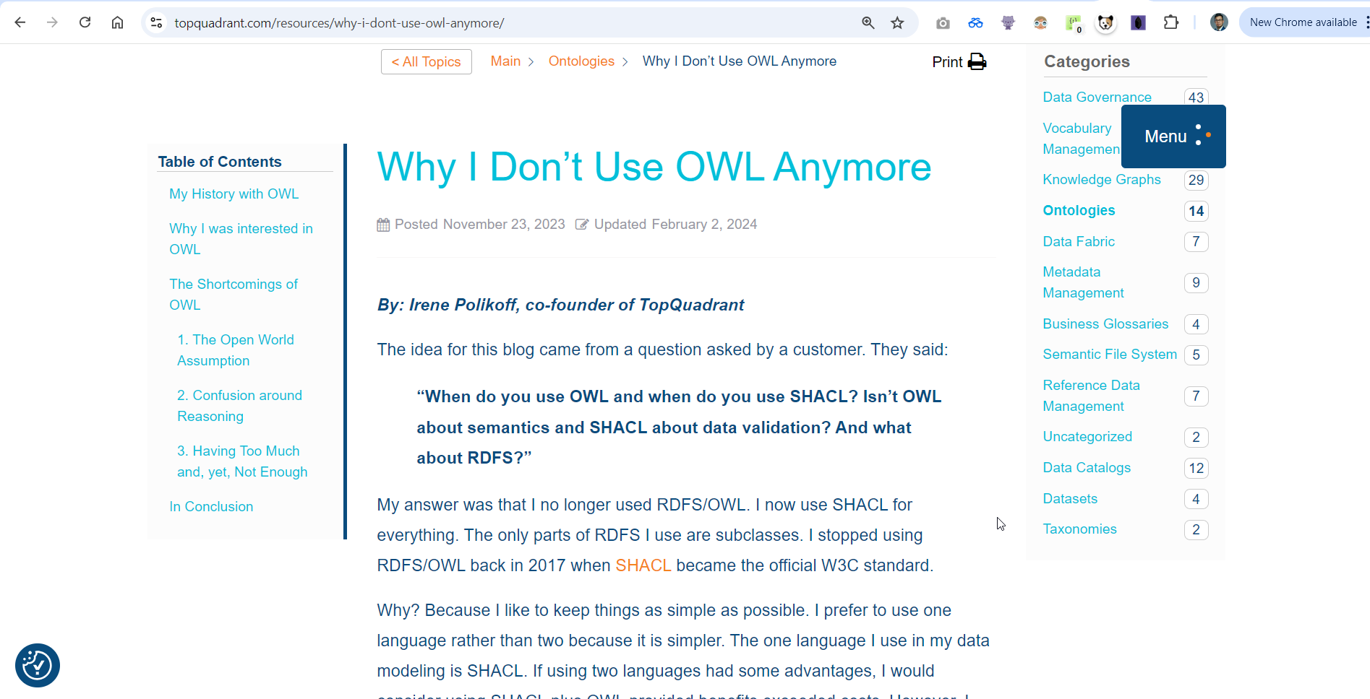
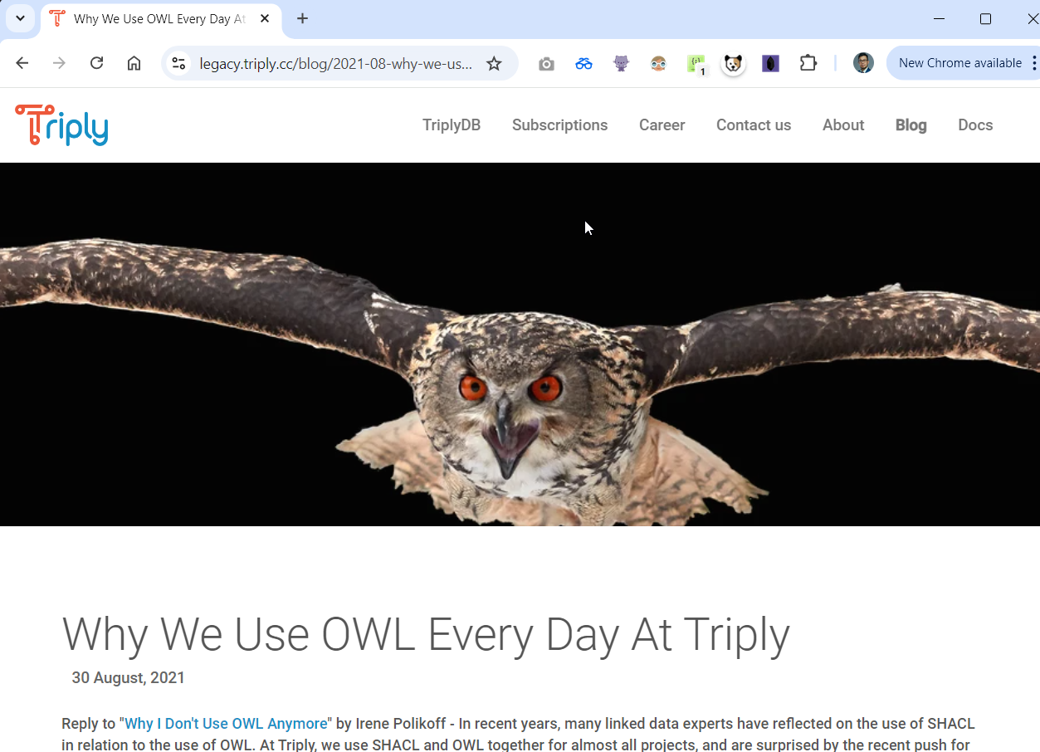
OWL vs SHACL
Is there really a need for using both? It depends.
Team OWL vs Team SHACL
A common argument is that when you don’t need a rich model and never really use logical reasoning/inferencing, then modeling using only SHACL should be fine

Slide 32
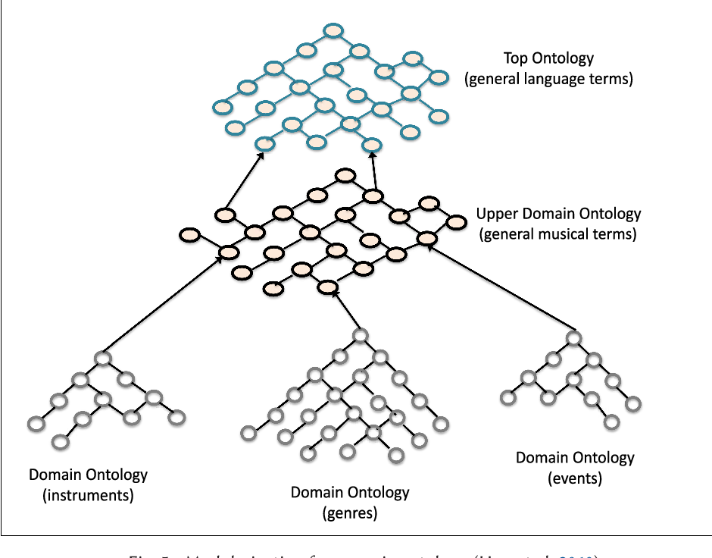
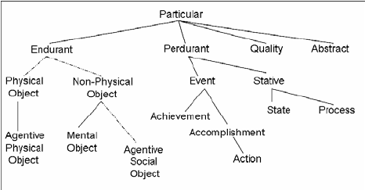
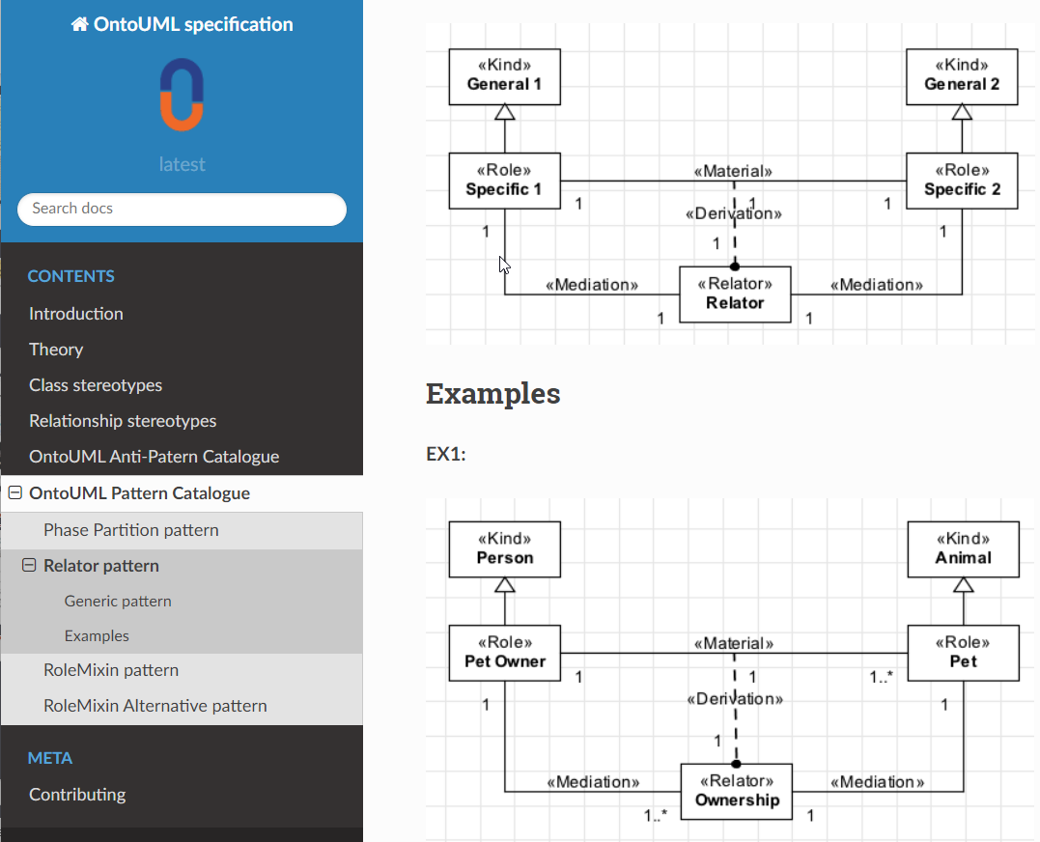
Relevant developments/frameworks: Foundational ontologies such as BFO, DOLCE and OntoUML/UFO
When creating a domain ontology, it may be wise to adopt a foundational (aka upper level) ontology
Dolce
Descriptive Ontology for Linguistic and Cognitive Engineering
BFO
Basic Formal Ontology
UFO/OntoUML
Unified Foundational Ontology
Often used in software engineering and enterprise modeling

Slide 33
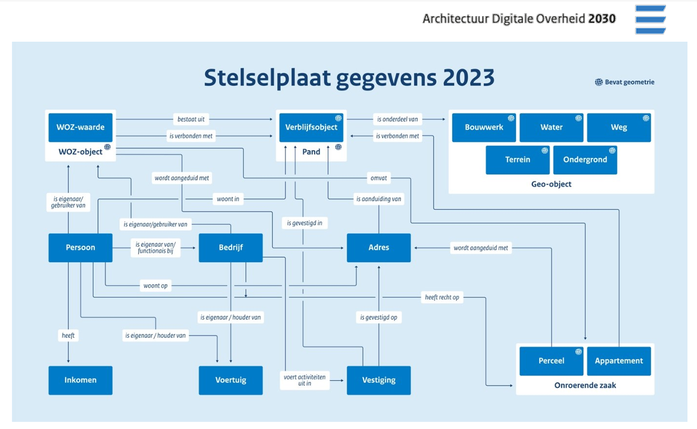
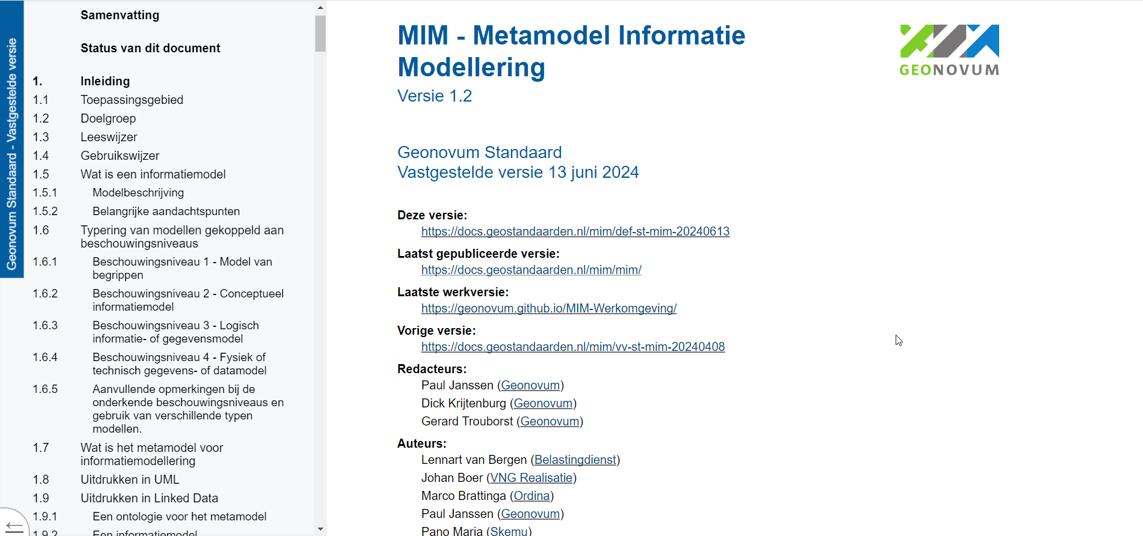
Relevant developments/frameworks: MIM and Reference Architecture 2030
Linked Data increasingly important for the Dutch public domain

Slide 34

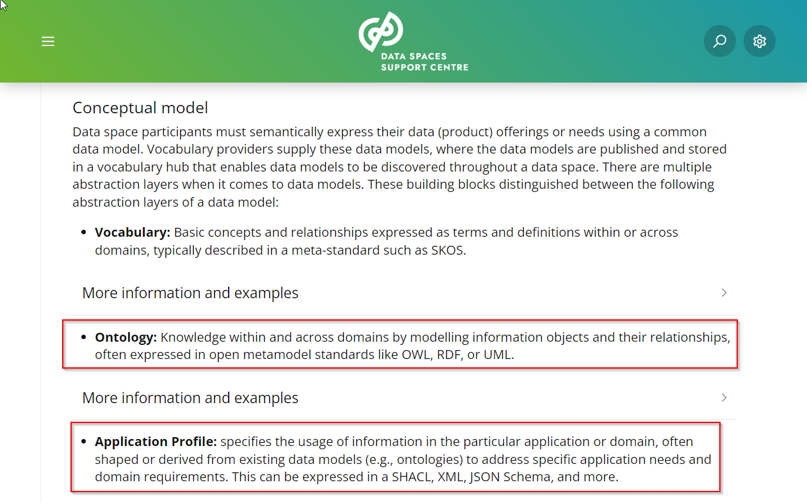
Relevant developments/frameworks: Data Spaces / Collaborative Data Ecosytems
OWL and SHACL mentioned in Data Spaces Blueprint as published by DSSC

Slide 35
References / Recommend reading
https://www.w3.org/TR/owl2-syntax/
https://www.w3.org/TR/shacl/
https://spinrdf.org/shacl-and-owl.html
https://medium.com/the-semantic-data-practitioner/diving-into-the-deep-end-of-rdf-owl-shacl-and-sparql-vs-terminusdb-data-products-9fe26bddab33
https://medium.com/fluree/what-is-shacl-with-examples-2697f659d465
https://www.ontotext.com/knowledgehub/fundamentals/what-is-shacl/
https://www.bobdc.com/blog/dontneedowl/
https://legacy.triply.cc/blog/2021-08-why-we-use-owl/
https://medium.com/@nfigay/do-you-know-what-upper-ontologies-are-and-the-value-it-brings-october-2021-5f43ee5b1553

Slide 36
Deep Dive: OWL

Slide 37
Pizza Ontology tutorial
In Protege Desktop
https://www.michaeldebellis.com/post/new-protege-pizza-tutorial
We will do Chapter 4 and 5 together
You are encouraged to complete the tutorial on your own after the sessions

Slide 38
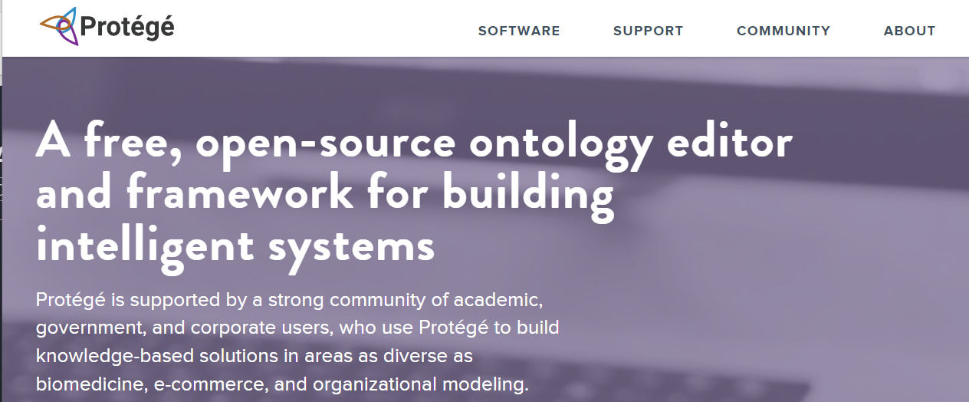
About Protege
Open Source
Developed by Stanford University
Protege desktop allows reasoning
Also web version available, but it does not have reasoning capabilities
Manchester OWL Syntax for class expressions
https://protegeproject.github.io/protege/class-expression-syntax/

Slide 39
If we have time: let’s make our own ontology
Let’s ask ChatGPT/CoPilot to help us create an OWL ontology in Protege Desktop about ...
A family tree (e.g. Person, Male/Female, hasChild, hasSibling, Uncle)
An office setting
...

Slide 40
References / Recommend reading
https://www.michaeldebellis.com/post/new-protege-pizza-tutorial
https://drive.google.com/file/d/1A3Y8T6nIfXQ_UQOpCAr_HFSCwpTqELeP/view

Slide 41
Deep dive: SHACL

Slide 42
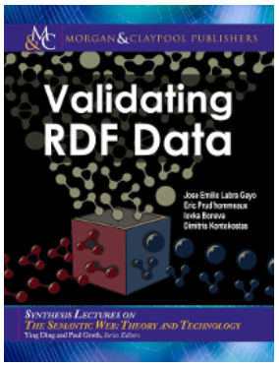
Validating RDF Data
Free HTML version: http://book.validatingrdf.com
We’ll do parts of Chapter 5 together

Slide 43
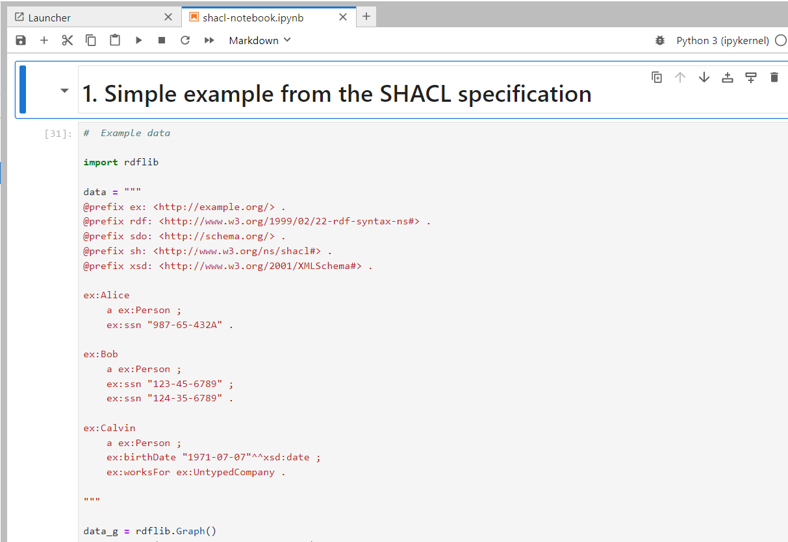
Notebook: shacl-notebook.ipynb
Let’s open `shacl-notebook.ipynb`

Slide 44
References / Recommend reading
https://www.w3.org/TR/shacl/
https://book.validatingrdf.com/
https://medium.com/fluree/what-is-shacl-with-examples-2697f659d465

Slide 45
Closing

Slide 46

Discussion
After today, how do you feel about OWL and SHACL?

Slide 47
Thank you for participating!

Slide 48
About Capgemini
Capgemini is a global business and technology transformation partner, helping organizations to accelerate their dual transition to a digital and sustainable world, while creating tangible impact for enterprises and society. It is a responsible and diverse group of 340,000 team members in more than 50 countries. With its strong over 55-year heritage, Capgemini is trusted by its clients to unlock the value of technology to address the entire breadth of their business needs. It delivers end-to-end services and solutions leveraging strengths from strategy and design to engineering, all fueled by its market leading capabilities in AI, cloud and data, combined with its deep industry expertise and partner ecosystem. The Group reported 2023 global revenues of €22.5 billion.
Get the future you want | www.capgemini.com

